Slide 1
Introducing the
European Case Law Identifier & the BO-ECLI project
Conference ECLI and Beyond | Athens | 8 June 2017
Marc van Opijnen
Project Coordinator BO-ECLI
marc.opijnen@koop.overheid.nl
This project is co-funded by
the European Union
Notes:
Please, fill in the Title in one or two lines,
as the place and date of the event.

Slide 2
Introduction
The Movie
ECLI Basics
ECLI Search Engine
BO-ECLI
Conference Programme.
ECLI and Beyond
Athens
8 June 2017
2
Notes:
Feel free to manage – design – arrange your content in one, two or more columns at the above two rectangular areas!

Slide 3
The Movie
https://youtu.be/nf4JlZJ-n9E
ECLI and Beyond
Athens
8 June 2017
3
Notes:
Feel free to manage – design – arrange your content in one, two or more columns at the above two rectangular areas!

Slide 4
ECLI Basics
ECLI and Beyond
Athens
8 June 2017
4
Notes:
Feel free to manage – design – arrange your content in one, two or more columns at the above two rectangular areas!

Slide 5
National & Cross-Border Case Law Search
Overarching Problems
How to cite a (foreign) decision?
How to find a (cited) judgment?
How to find translated versions or summaries?
How to find court decisions about / citing (EU) legislation or other decisions?
Needed: common information architecture.
ECLI and Beyond
Athens
8 June 2017
5
Notes:
Feel free to manage – design – arrange your content in one, two or more columns at the above two rectangular areas!

Slide 6
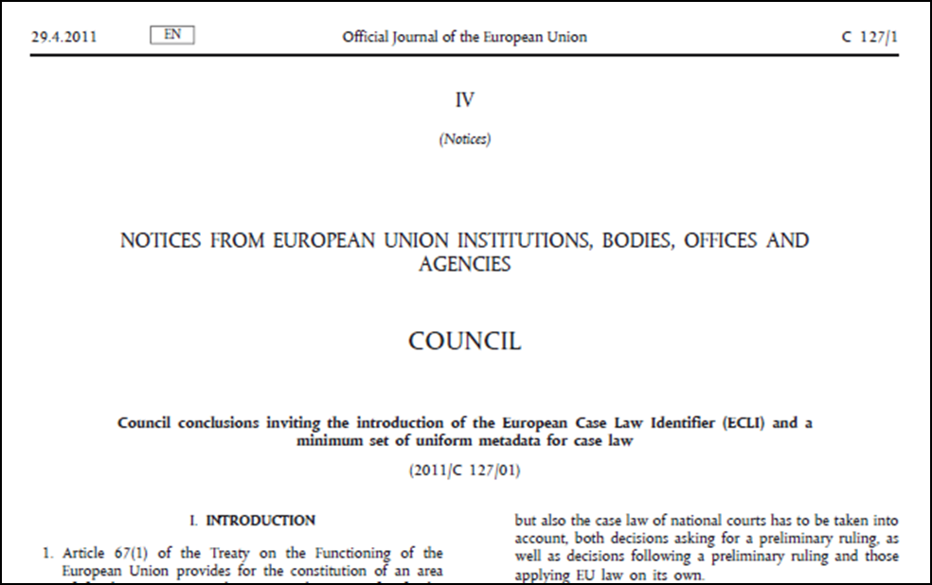
ECLI
Basics
A first building block for improving (cross-border) access to online court decisions
EU Council Conclusions 2010
ECLI and Beyond
Athens
8 June 2017
6
Notes:
Feel free to manage – design – arrange your content in one, two or more columns at the above two rectangular areas!

Slide 7
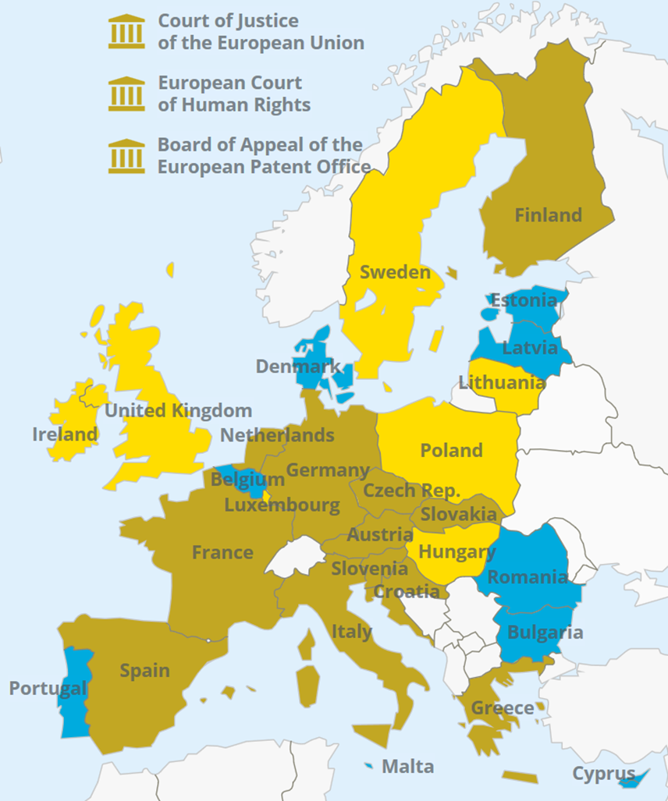
ECLI
Basics
A first building block for improving (cross-border) access to online court decisions
EU Council Conclusions 2010
ECLI:ES:TS:2014:3876
Common set of metadata
National ECLI coordinator
ECLI Search Engine.
ECLI and Beyond
Athens
8 June 2017
7
Notes:
Feel free to manage – design – arrange your content in one, two or more columns at the above two rectangular areas!

Slide 8
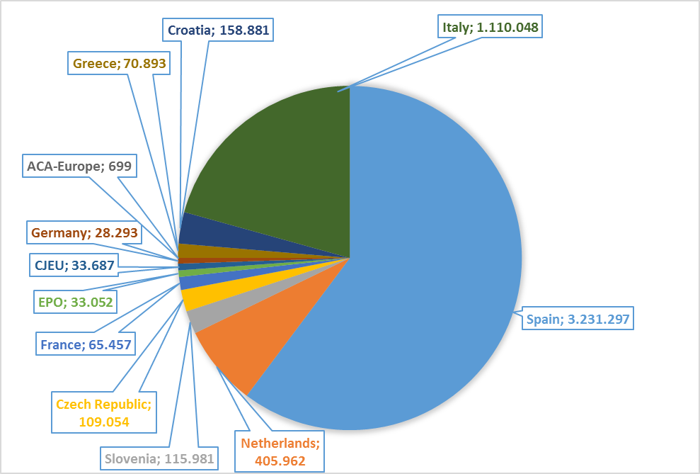
ECLI Framework
The ECLI Search Engine
ECLI and Beyond
Athens
8 June 2017
8
Notes:
Feel free to manage – design – arrange your content in one, two or more columns at the above two rectangular areas!

Slide 9
Building on ECLI
Partners
This project is co-funded by
the European Union
Italy
Institute of Legal Information Theory and Techniques
Alma Mater Studiorum University of Bologna
University of Torino
Spain
Documentary Centre for the Spanish Judiciary
Croatia
Ministry of Justice of the Republic of Croatia
Supreme Court of the Republic of Croatia
Romania
Ministry of Justice of Romania
Belgium
Federal Public Service Justice
Germany
Federal Office of Justice of Germany
Federal Administrative Court of Germany
Czech Republic
Supreme Court of the Czech Republic
Estonia
Centre of Registers and Information Systems
Greece
Hellenic Council of State
European Public Law Organization (EPLO)
The Netherlands
Council of State
Publications Office of the Netherlands (UBR|KOOP) (coordinator)

Slide 10
Building on ECLI
Objectives
(Further) national implementation of ECLI in 8 Member States (BE, CZ, DE, EE, EL, HR, IT, NL)
Linking data
Assess current use and discuss ECLI 2.0
Promotion of ECLI for use in IT-systems and legal citations
Research on online publication of case law and draft guidelines.
ECLI and Beyond
Athens
8 June 2017
10
Notes:
Feel free to manage – design – arrange your content in one, two or more columns at the above two rectangular areas!

Slide 11
Conference Programme
Thursday 8 June:
ECLI and Beyond: Improving Online Access to Court Decisions
16:00 ECLI in Belgium, Czech Republic & Romania
16:25 BO-ECLI Workstream 2: Automatic Extraction of Legal Links in the European Context
16:50 ECLI in Latvia, Cyprus & Estonia
17:15 Break
17:35 ECLI in Greece, Croatia & Germany
18:00 BO-ECLI Workstream 3: ECLI 2.0
18:25 ECLI in the Netherlands, Italy and Spain
18:50 BO-ECLI Workstream 0: Policy & practice regarding publication of court decisions on the internet within the EU
19:15 Close of the day
20:30 Buffet dinner
ECLI and Beyond
Athens
8 June 2017
11
Notes:
Feel free to manage – design – arrange your content in one, two or more columns at the above two rectangular areas!

Slide 12
Conference Programme
Friday 9 June:
ECLI and Beyond: Improving Online Access to Court Decisions
10:00
Monika Mazur: ECLI and creation of other Metadata (References to previous case law cited by the Court of Justice of the EU)
Marcin Baryn: The challenges of presenting national and EU case law on EUR-Lex
Gijs van Dijck: ECLI codes and network analysis
11:15 Break
11:45
Laris Vrahimis: The Free Access to Law Movement and Cylaw.org as an example of the Lii model
Clemens Wass: Open Data as a resource for Legal Tech projects and Start-ups
Michael Pikramenos: Cyberjustice in European judicial systems – Open Data and Access to Justice
13:00 Close of the Conference
13:30 Snack Lunch
ECLI and Beyond
Athens
8 June 2017
12
Notes:
Feel free to manage – design – arrange your content in one, two or more columns at the above two rectangular areas!

Slide 13
Enjoy the Conference!
BO-ECLI
www.bo-ecli.eu | info@bo-ecli.eu
This project is co-funded by
the European Union
This presentation has been produced with the financial support of the Justice Programme of the European Union. The contents of this publication are the sole responsibility of the partners of the BO-ECLI project and can in no way be taken to reflect the views of the European Commission.

